Slide 1
Phase I Funding Proposal
IEEE Central Texas Section
Fall Planning Meeting 2017
San Marcos, Texas
Adviser: Sriram Vishwanath, sriram@ece.utexas.edu

Slide 2
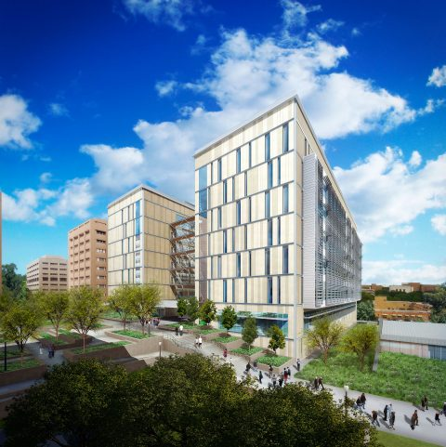
Branch Overview
New Building, New Goals!
Increase cooperation with society chapters: ComSoc, CS, PES, RAS, HKN, and WECE
Increase retention and active membership

Slide 3
Branch Executive Officers
Ali de Jong, Chair
Taylor Zhao, Vice Chair
Yuriy Minin, Executive Director
Shariq Memon, Corporate Director
Isabelle Villamiel, Treasurer
All officers serve terms of one school year.

Slide 4
Budget and Costs
Major source of funds: corporate support
Other sources include student organization grants and the Central Texas Section
Some costs recouped through participation fees and other charges (ex: T-shirt Sales)
Expected expenditures ~$10,000 for all activities during 2017 - 2018

Slide 5
Previous CTS Contributions
Last year’s CTS Phase I funding:
IEEE Welcome Week ($400)
Leadership Retreats ($300)
SPAX ($300)

Slide 6
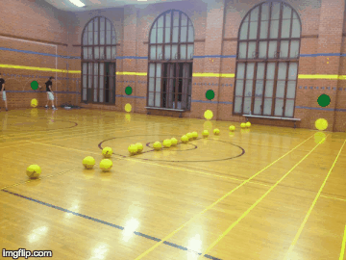
IEEE Welcome Week
Events to kick off the school year and get new members involved
Dodgeball, Super Smash Bros Tournament , Pizza Panel

Slide 7
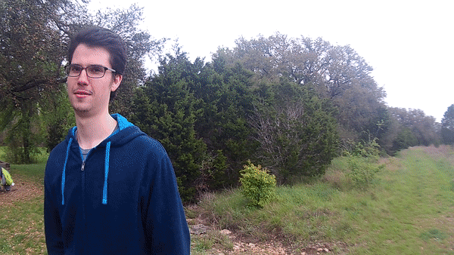
Leadership Retreat
Fall Retreat: Team building, Planning for the year
Spring Retreat: Express interest in greater involvement

Slide 8
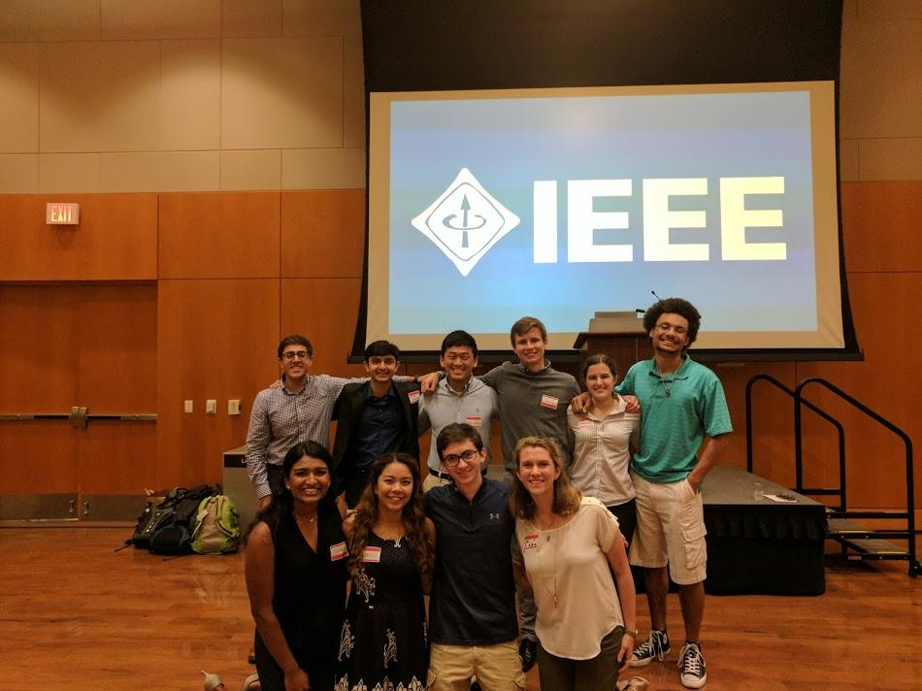
SPAX
Opportunity for students to hear from industry professionals and professors about the non-technical side of industry

Slide 9
CTS Commitment
Request for 2017 is $1,000:
IEEE Welcome Week ($400)
Leadership Retreats ($300)
SPAX ($300)

Slide 10
Conclusion
CTS funding is crucial for non-corporate sponsored events
Increase member engagement and recruitment

